Slide 1
Eclectic approach or multimodal experience: a professional development programme for language teachers
Cecilia Goria and Marion Sadoux
University of Nottingham, UK & China
Reshaping Languages in HE
Southampton 2014

Slide 2
Overview of this presentation
1) The role of Multimodality in a professional development programme for language teachers
2) De-professionalization & re-professionalization of language teachers
Notes:
We will look at the process of reshaping languages from a different angle: not directly from language teaching but indirectly through language teacher training.
The tangible setting is the MA in DTLT (professional development).
We want to highlight 2 points which we feel sit nicely in the conversation about reshaping:
1) Multimodality to enhance our learners’ experience and also the experiences of our leaners’ learners, i.e. the next generation of language learners. “Reshaping” - Me
2) Re-professionalization of the de-professionalised language. “Reshaping” – Marion

Slide 3
Structure of the MA in DTLT
University calendar
Entirely online – distance learning and teaching
2 years part-time
Supported by Moodle
Introductory module + 2 modules per semester + dissertation
Target audience
Notes:
Talk briefly about the structure of the programme

Slide 4
Design: Toohey’s (1999) typology:
Approaches:
traditional
cognitive/constructivist
experiential
performance-based
socially-critical
Criteria:
view of knowledge, process of learning, goals and how they are expressed, choice and organization of content, purpose of assessment and methods, resources and infrastructure
Notes:
The programme has been design with Toheey’s typology of pedagogical approaches to course design in mind.
Why? Because :
1) It clearly depicts the main features of different approaches
2) It identifies the features of the pedagogical approaches which can then be applied to different models
3) It provides an excellent set of criteria for course designers to refer to in each step of his/her design, providing a “toolkit” to maintain the component of the design aligned in terms of the pedagogical choice.

Slide 5
Design of the MA in DTLT
The cognitive approach - influenced by the theory of social constructivism (Piaget 1926; Vygotsky 1978). It:
promotes the personal construction of knowledge
Sharing and collaborating
focuses on the depth of content rather than quantity
uses real-world resources for problem identification and solving
provides resources for independent investigation
Involves self and peer assessment
The teacher's role is to elicit and facilitate levels of analysis, which the learners would not have reached on their own.
The experiential approach promotes:
personally relevant learning
mutual teacher-student respect, collaboration, support and openness
The teacher's role is to:
assist planning
facilitate group-work
offer guidance while students determine their own learning goals
be involved in the planning of the unit
Notes:
Combination of approaches. Main features highlighted

Slide 6
Multimodality
Multimodality is the practice of representing the content knowledge in different modes, typically verbal (printed, spoken words) and non-verbal (illustrations, photos, videos, and animation) (Moreno & Mayer 2007)
Multimodality entails not only accessing information in different formats but also establishing interactivity between these representations (Guichon & McLornan 2008)
An interactive multimodal learning environment is one in which, during the learning, the learner is able to interact with the presented content, e.g. play/pause/forward while watching a narrated animation; click on hyperlink to get additional information (Moreno & Mayer 2007)
Notes:
Back to Multimodality – definition – what is Multimodality

Slide 7
Multimodality within the MA in DTLT
Multimodality - digital technologies intensify multimodal possibilities
Multimodal semiotic experience – meaning making through different representations of content
Notes:
Interpretation of Modality within the context of the MA:
Although multimodality does not equate to technology, digital technology intensify multimodal possibilities.
We also take multimodality in its core sense: the process of making meaning through different representations

Slide 8
Why Multimodality ? 1) Learning
To support our learners’ learning:
Fosters construction of knowledge (Moreno & Meyer 2007) & collaboration
Leads to the personal making of meaning (Gunther Kress – YouTube)
Enhances motivation, engagement and assists comprehension and retention (Sankey et al. 2010)
To benefit our learners’ learners (language) learning:
Beneficial for language learning (Guichon & McLornanr 2008, Gilakjani et al. 2011), including when the focus of multimodality is on gaze, body language, gesture, in addition to speech (Price 2013)
Notes:
Research shows that it is beneficial for learning and it does so in alignment with out pedagogical choices. So construction of knowledge is aligned with the cognitive approach we adopted to inform our design; the personal making of meaning is in line with our focus on learning which is personally relevant a central feature of our experiential approach.

Slide 9
Why Multimodality ? 2) Diversified experience
To provide our students with a diversified learning experience in order to improve their ability to deal with their diverse professional contexts (our learners’ language learners).
digital literacy
access to technology
body of students
institutional limitations
Notes:
Focus on developing multimodal literacies of teachers to provide them with the tool to deal with diverse contexts and yet not miss out on its benefits for learning

Slide 10
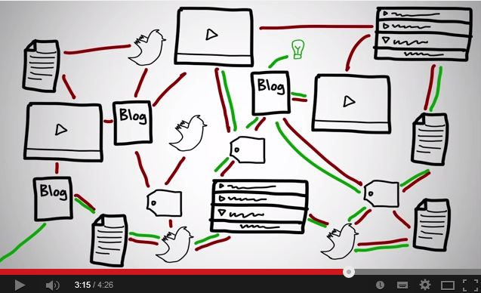
Multimodality and MA in DTLT
1) The programme provides students with different representations of content, e.g. structure of Moodle, video (spoken + graphics), readings (written).
language and print (linguistic); images and graphics (visual); sound (auditory); movement and gesture (gestural); texture and space (spatial)
Notes:
How is multimodality implemented in the MA?
Communication involves highly integrated modes of language and print (linguistic), images and graphics (visual), music and sound (auditory), movement and gesture (gestural) and texture and space (spatial).

Slide 11
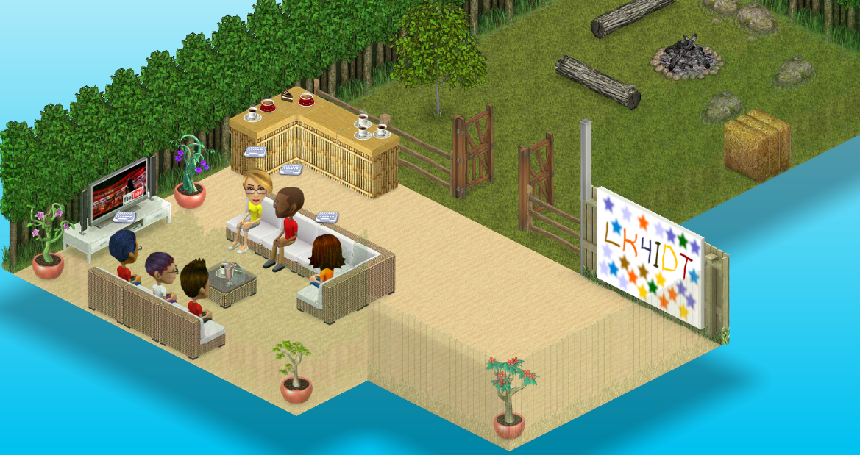
Multimodality and MA in DTLT
2) It requires that students make meaning through different representations of content, e.g. SmallWorlds
Notes:
Reading + sensory & affective

Slide 12
Multimodality and MA in DTLT
3) It encourages students to share different representations of content, e.g. use of Popplets to share notes & the structure of their assignments
written + visual (links between Popplets)
http://popplet.com/app/#/home

Slide 13
Multimodality and MA in DTLT
4) Requires students to construct knowledge by producing different representations of content, e.g. videos for LKSLA:
spoken + image + animation
http://screencast-o-matic.com/watch/c2fYFanuRM
Notes:
Students are provided with a multimodal context and are expected to engage with multimodality when produce coursework, assignments ,etc.

Slide 14
Multimodality and MA in DTLT
5) “Reshaping” - Multimodal literacies in the repositioning from learners to teachers. Multimodality for the next generations of language learners.
spoken + animation & text + image
http://livingenglish.pbworks.com/w/page/78722915/Living%20English%20Week%202#/
written + animation
https://www.youtube.com/watch?v=mT9rzEoxMLk#t=44
spoken + graphics + image
http://lowerfivefrenchjeb.wikispaces.com/L%27imparfait+and+how+to+form+it
Notes:
Course Design assignment
Spoken + animation: go animate vid; text + image: pronouns poster and explanation underneath
Cater for different backgrounds, different contexts.

Slide 15
Success and challenge End of 1st Year
Multimodality to support the learning process – role switching
Multimodality as a tool to cater for a multiplicity of language learning and teaching professional contexts.
Notes:
The mere implementation of their multimodal literacies shows that as a leaning experience was successful
In terms of providing a tool to cater for their diverse professional contexts, it is too early for us to say

Slide 16
De-professionalisation – loss of autonomy, loss of authority and subordination to external supervision Demailly & de La Broise (2009)
Distribution of working time and Schizophrenic reporting systems (Meetings, assessments, lack of time for teaching, shortening of teaching units);
Destabilisation of employment status (contractualisation of teaching and research)
Destabilisation of existing groups and destruction of capacity for collective action

Slide 17
De-professionalisation and the Merchandisation of Education
Withdrawing of state funding and vagaries of governmental policies had a devastating impact on foreign language education in all sectors and on the status of language teachers;
IWLP in the 1990’s drew on a large body of unqualified teachers – native speakers;
In house staff training in lieu of qualifications or professionalisation

Slide 18
Re-professionalisation and the shifting Paradigms of Teaching and Learning in the 21st Century
Reshaping Languages in HE requires new skills, more competencies, more flexibility, more entrepreneurship, more commitment;
Increasingly trivial use of technology to enhance learning requires us to reinvent our roles and to relinquish power to learners;
How can language educators be taken seriously in HE without engaging with their scholarly fields (T&L, SLA, Psychology of Education)?

Slide 19
Re-professionalisation ? “learning to become” (Douglas & Brown, 2010)
Professionalism as “becoming”;
Not through the instruments of managerialism or through institutional or national policy;
Through open and fluid exchanges within communities of practice; developing and rewarding reflective practices, supporting opportunities for recognised accredited development (MA, PgCerts, PhD by prior output)

Slide 20
Bibliography
Demailly, L. & de la Broise, P. (2009) The Implications of Deprofessionalisation , Socio-logos. Revue de l'association française de sociologie [En ligne], 4 | 2009, mis en ligne le 07 mai 2009, Consulté le 04 juillet 2014. URL : http://socio-logos.revues.org/2307
Douglas, T. And Brown J.S. (2010) Learning for a World of constant Change, University Research for Innovation, Weber James& Duderstadt editors.
Gunther Kress: What is multimodality? Available on YouTube
https://www.youtube.com/watch?v=nt5wPIhhDDU
Guichon N. & McLornan S. (2008) The effects of multimodality on L2 learners: Implications for CALL resource design. System 36, pp. 85-93
Moreno R. & Mayer R. (2007) Interactive Multimodal Learning Environments. Edicational Psychology Review, 19, pp. 309-326
Piaget, J. (1926) The language and thought of the child. New York: Harcourt, Brace, Jovanovich.
Price K. (2013) Multimodal interfaces: Blending gaze, gesture, movement and
speech to overcome the limitations of keyboard, mouse & Touchscreen. WorldCALL, 10-13 July 2013, Glasgow.

Slide 21
Bibliography
Sankey M. et al. (2010) Engaging students through multimodal learning environments: The journey continues. Proceedings ascilite Sydney 2010.
Toohey, S. (1999). Beliefs, values and ideologies in course design. In Designing courses for higher education. Buckingham, SRHE and OUP, pp. 44-69.
Vygotsky, L. S. (1978) Mind in society. Cambridge, MA: Harvard University Press.
Gilakjani A. et al. (2011) The Effect of Multimodal Learning Models on Language Teaching and Learning. Theory and Practice in language Studies, 1, 10, pp. 1321-1327.

